Slide 1
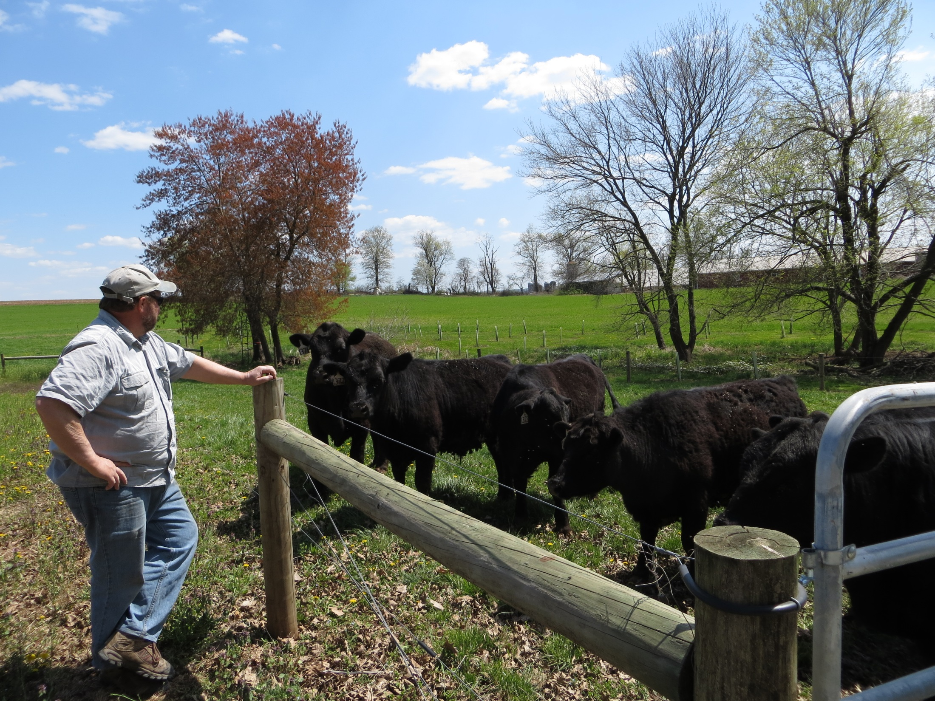
Stroud Farm Stewardship Program:
Chiques Creek Farm Opportunities

Slide 2
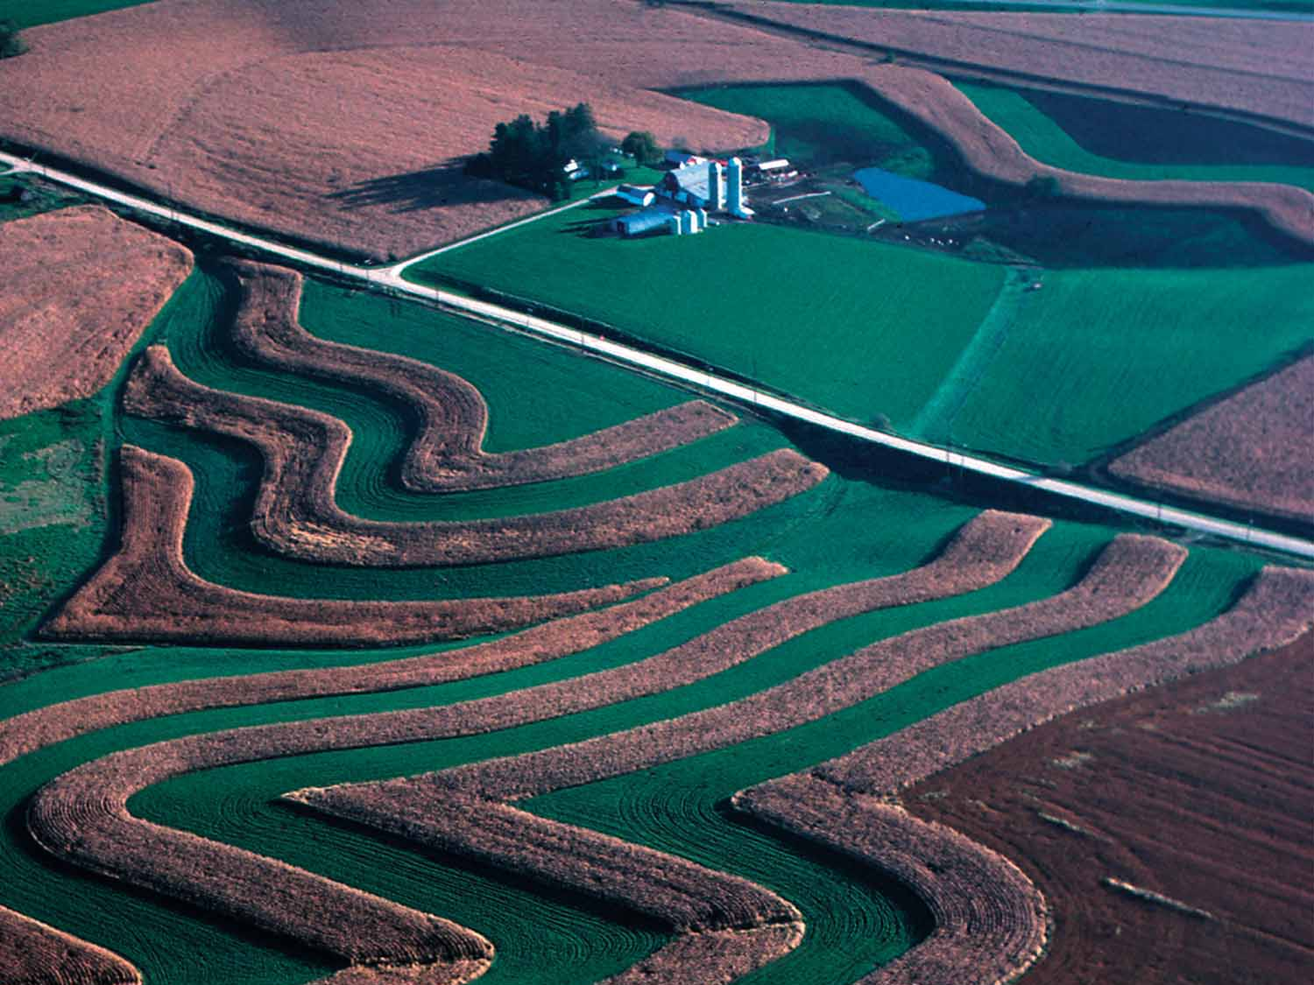
OVERVIEW
What is the Stroud Center?
Stroud’s Farm Stewardship Program
USDA NRCS Regional Conservation Partnership Program (“RCPP”)
Photo: USDA NRCS

Slide 3
Advancing knowledge and stewardship of fresh water systems through research, education, and restoration
Notes:
3

Slide 5
Illustration by Frank McShane for Schuylkill Action Network
Notes:
5

Slide 6
Stroud Farm Stewardship Program
Open to farmers taking big steps:
Getting all required plans
Installing all needed BMPs
Offers $4,000 voucher for each acre put into forested buffer ($20,000 maximum)
Can be used combined with USDA RCPP to cover costs for BMPs and technical assistance

Slide 7
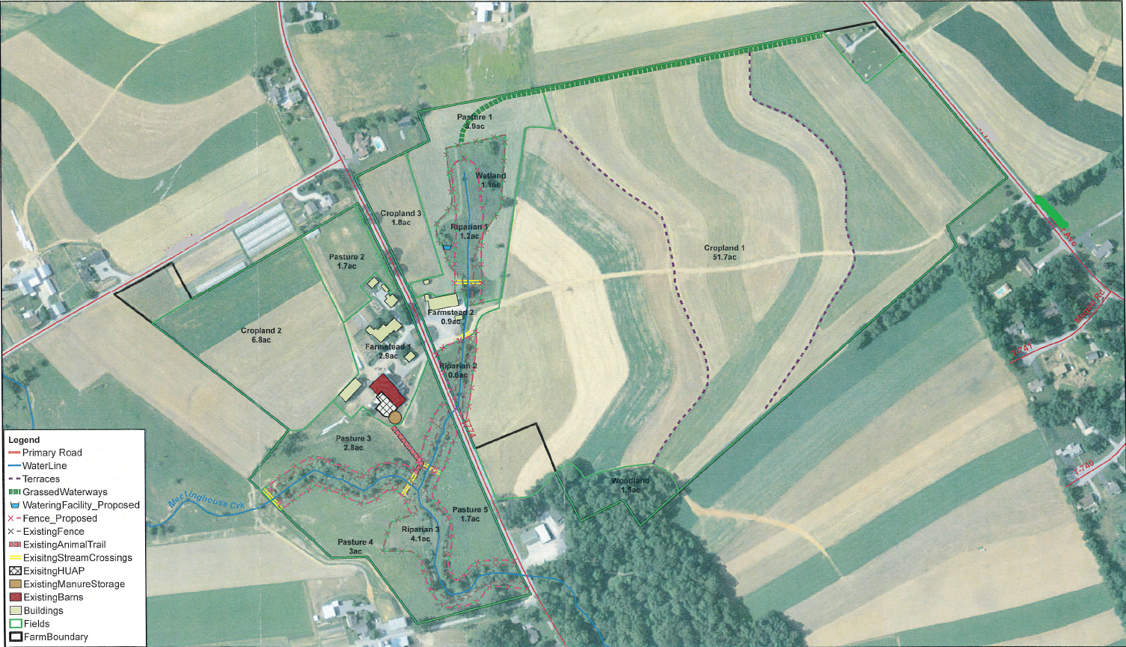
Example farm project and technical assistance

Slide 8
Example of voucher use
Barnyard near stream with manure runoff concerns
BMPs to fix cost $80k
Photo Credit: Team Ag Inc.

Slide 9
Example of voucher use
USDA RCPP cost share: $70k
2.5 ac forest buffer: $10k voucher
Photo Credit: Team Ag Inc.

Slide 10
Forest buffers and livestock exclusion
Stroud Farm Stewardship Program offers $4,000 per acre for new buffers
USDA RCPP requires 35’ forest buffers
These programs can be combined

Slide 11
How can farmers participate in these programs?
Contact Stroud, NRCS or private ag consultants (Team Ag or Red Barn Consulting)
Meet to discuss goals and needs for farm
Apply for NRCS RCPP
Sign up for Stroud Farm Stewardship Program
Photo Credit: Team Ag Inc.

Slide 12
Contact Info:
Stephanie Eisenbise
Stroud Water Research Center
(610) 268-2153 ext. 311
seisenbise@stroudcenter.org

